Slide 1

DIY Async Message Pump
Lessons from the trenches
@danielmarbach
Notes:
Welcome.
Patient records of 4 million patients in Switzerland
Huge Legacy System, 13 servers, millions lines of code
Customer came and said wouldn’t it be cool if we could do general purpose invoicing
I don’t have a lot of money but I’m sure you can make it happen
Have you ever had that in your project?
Because we knew we needed to address temporal coupling in our architecture to make it possible to deal with all the webshops that would connect to our services we leveraged a message queuing system to be able to better scale, predict the load and not loose a maintenance window (webshop are online 24h)
We started with a small use case around invoice refunds. Went to the drawing board and discussed new architecture approaches. We chose a step by step approach because we couldn’t afford to Microservice the shit out of the system. This is the architecture we came up with

Slide 2
DB Cluster
DMZ
Backend
WCF Services
Front
Windows Service
Back
Storage
Read / Write
ADO.NET
Query
Cache
Subscriber
Refund
Refunded
Messaging Cluster
Queues
Notes:
We can give the refunding client an immediate fake state and send a message to the legacy system
While the legacy system was processing refunds it could fire events and the demilitarized zone could subscribe to those messages and update the front-end cache
The webshop clients could ask for state as much as they wanted we didn’t bother anymore
Decoupling especially temporal
Awesome scaling
Throttling
Retries and business transactions to stateful middletier
Intent capturing request as messages
Fully bought into messaging the next hard decision had to be taken:

Slide 3


Build
or
Buy
Notes:
Build or buy
TLDR: We went for buy in this project but in another project I was part of we didn’t. After all building a messaging library can’t be that hard right? Let me walk you through the challenges we’ll faced in building a robust messaging library

Slide 4
DB Cluster
DMZ
Backend
WCF Services
Front
Windows Service
Sending
Back
Storage
Read / Write
Receiving Publishing
ADO.NET
Query
Cache
Subscriber
Refund
Refunded
Messaging Cluster
Queues
Notes:
What basic features do we expect from the messaging middleware
Sending messages – Mapping a business intent to a message, hopefully a command
Receiving – Getting a message out of the queue, dispatch businesslogic and eventually publish more messages, hopefully an event
Super simple isn’t it? Let’s see some code!

Slide 5
Building the
pump
Notes:
Let’s build the pump – ThePump.cs
Show the code only, don’t run

Slide 6
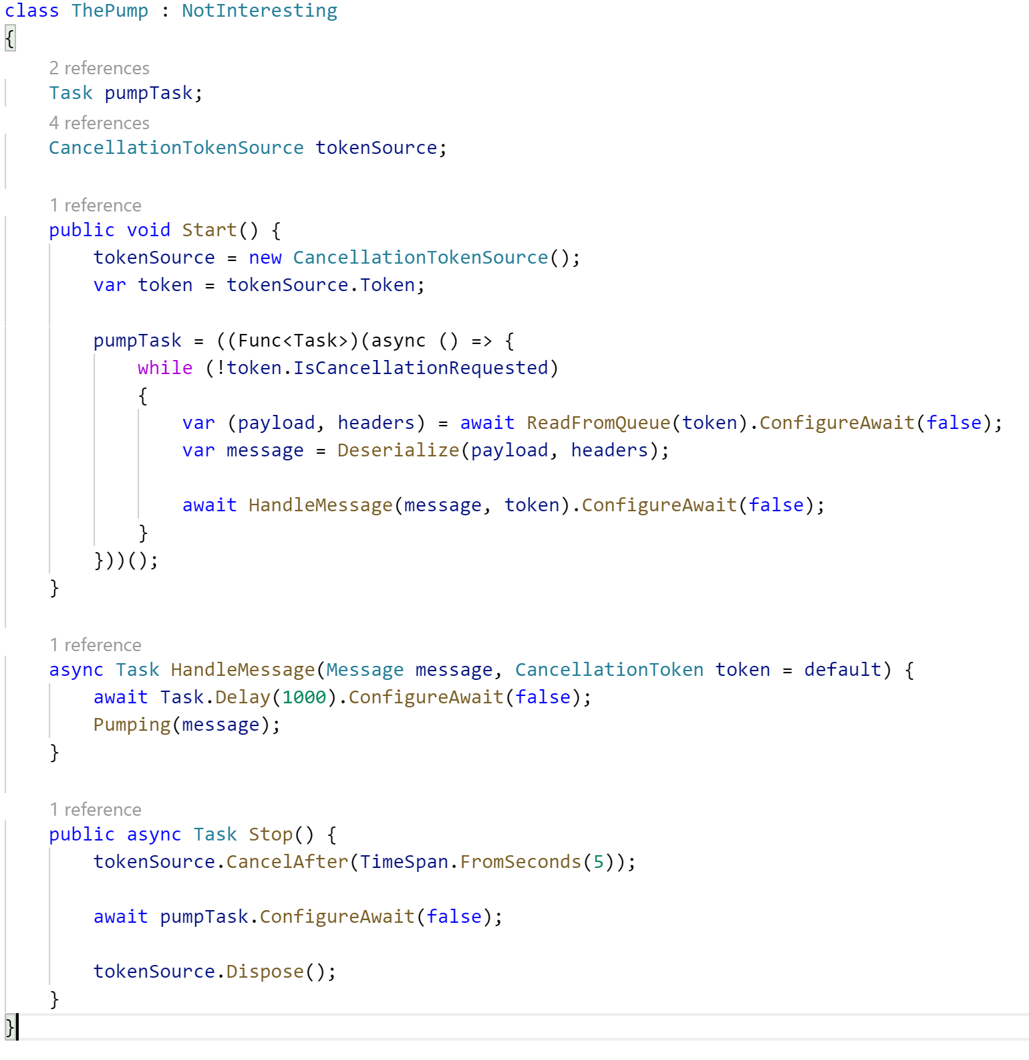
Notes:
Highlights:
Offload the receiving from the queue away from the mainthread with Task.Run
Loop until cancellation happens
Receive payload and headers from the queue
Invoke the business logic by handling the message after it was deserialized
TPL Quiz question:
Why aren’t we using Task.Factory.StartNew with or without the LongRunning flag?
Could we use async void instead of Task.Run?
Some SDKs have built in serialization and deserialization, some transports distinguish between headers and payload and some don’t
Showing here a long polling API but you can also imagine that the SDK itself has “push” capabilities

Slide 7

var (payload, headers) = Serialize(message); await queue.Send(payload, headers);
sending
Easy!
Notes:
We did not show the sending part as illustrated in the diagram before, after all Sending is pretty straight forward isn’t it?
Serialize the headers and payload and send it to the destination queue
I'll explore the challenges lurking in the sender implementation later
Let’s recap what we just saw in code

Slide 8

TPL handwaving
Cooporative cancellation 101
Async / Await
Ship it!
It worked until
Notes:
With a little bit of TPL handwaving, some cooperative task cancellation 101 and async / await we’ve been able to build a good and robust message pump that works until…

Slide 9
u
u
u
Rush hour
Notes:
Our small webshop got that precious item that was sold out everywhere else and people started buying it like crazy

Slide 10
Pump
Handler
Network send time
Queue wait time
Processing time
Notes:
Let’s see what happened due to the code
The critical time went through the roof top, what is critical time
Critical time is the time between when a message is sent and when it is fully processed. It is a combination of:
Network send time: The time a message spends on the network before arriving in the destination queue
Queue wait time: The time a message spends in the destination queue before being picked up and processed
Processing time: The time it takes for the destination endpoint to process the message
We can address this easily. Sleeves back and get some cooding done

Slide 11
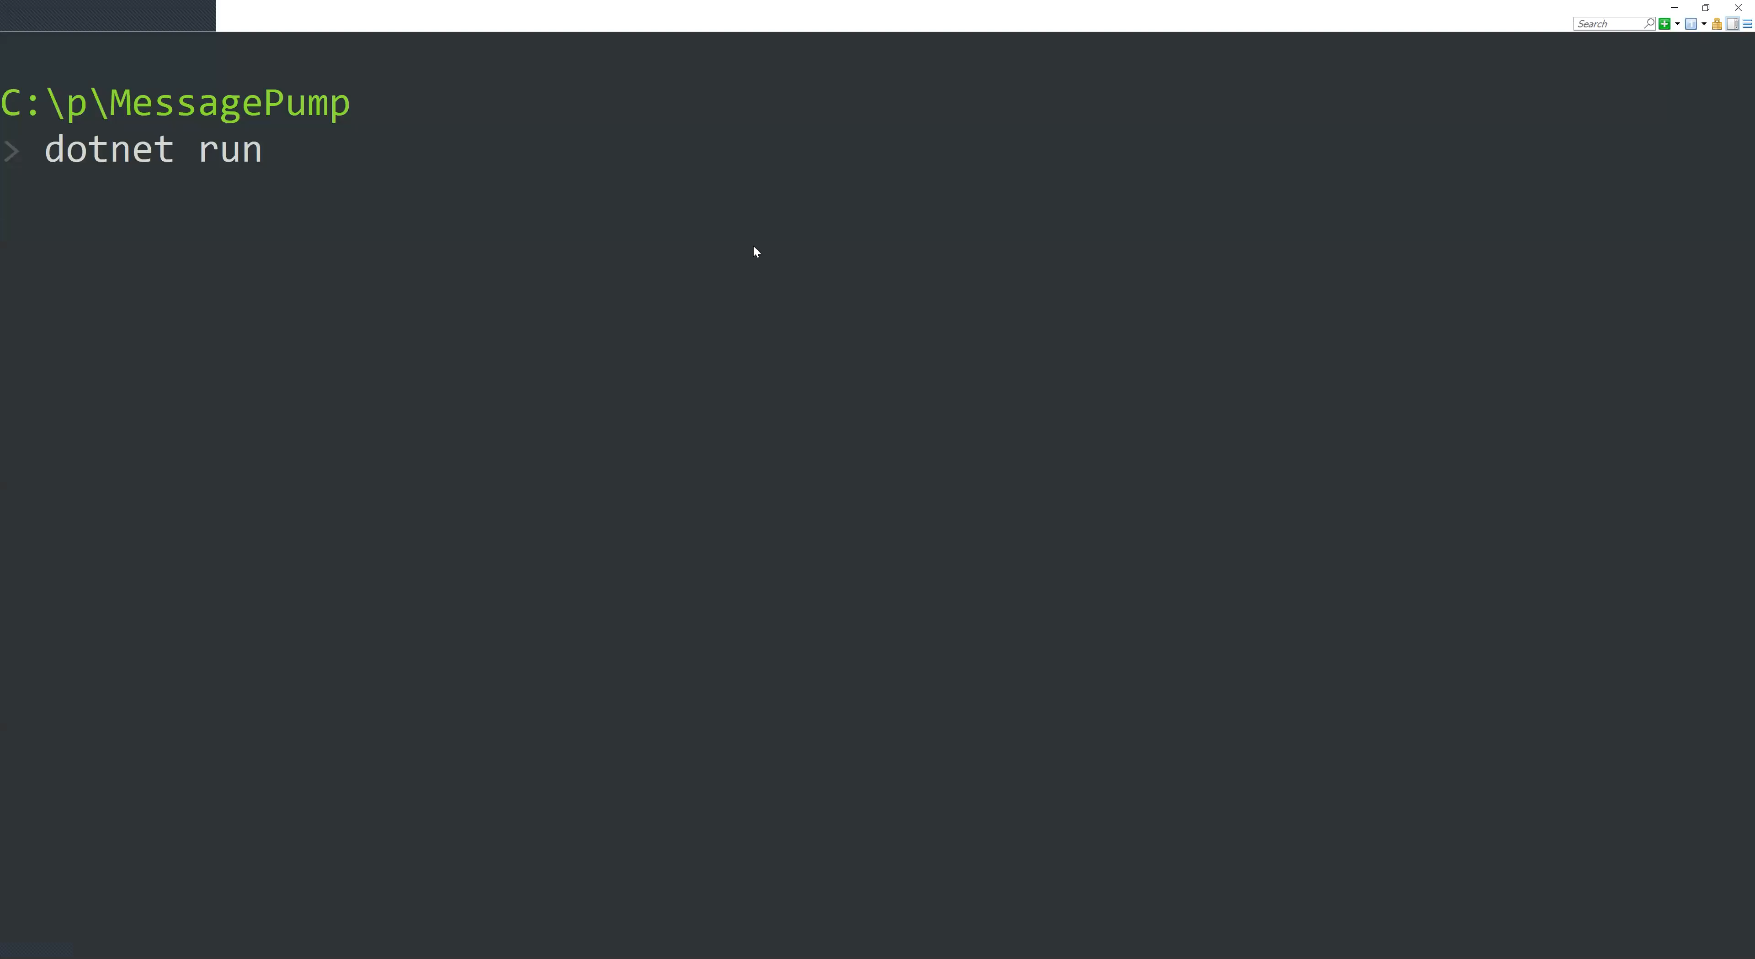

Slide 12
Let’s throw in some
concurrency
Notes:
Run the previous code first, then show the new code
Let’s unleash the concurrency – TheConcurrencyPump.cs

Slide 13
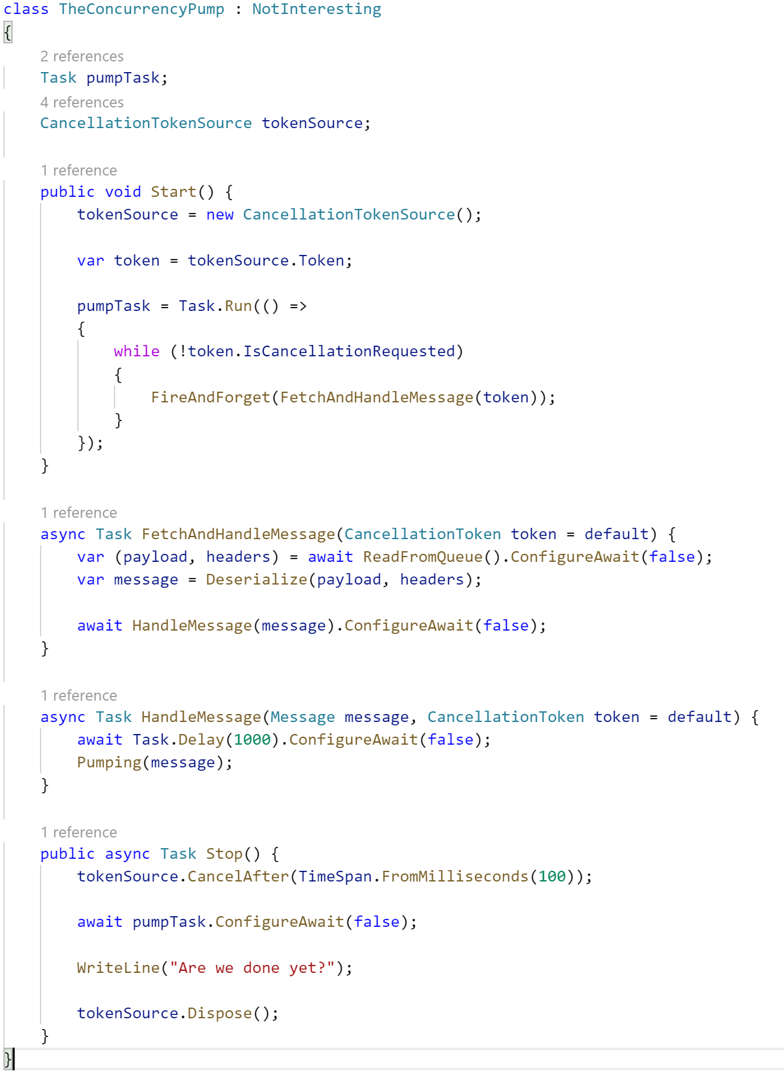
Notes:
Highlights
- Instead of sequentializing the flow we no longer await the handling of the message
- Everything else is the same
- We just have to be careful to log when things go wrong

Slide 14
Just a tiny change…
Introduce Fire & Forget
Ship it!
It worked until
Notes:
Since it is just a tiny little change we don’t need to do an extensive Q&A. Ship it
It worked until

Slide 15
u
u
u
Rush hour
Notes:
Again this damn rush hour. If only we wouldn’t be making that much money. Life would be so much easier, oh wait! We are actually loosing money right now…

Slide 16
DB Cluster
Pump
Storage
Notes:
The pump runs now with unbounded concurrency. So theoretically until the message queue starts throttling us the pump is picking up as many messages as it possible can without any limitations. Any limitations is a lie. The code we call always has limitations unless it is specifically built to be without it. But if you are doing regular DB calls in the code that gets invoked by the pump at some point you might be depleting the connection pool resources and start running into weird DB and transaction timeouts due to overloads of the DB.
Once that happens we loose the whole benefit why we introduced storage based queues in the first place. Remember we could have queues in memory but then we have no possibility to scale queues independent from the process that consumes them plus the process can grow indefinitely in terms of resource usage. With file backed queues the queuing capability has different scaling vectors. But once we start consuming messages in an unbounded way all bets are off. The weakest link in the chain will fall over due to missing throttling capabilities

Slide 17
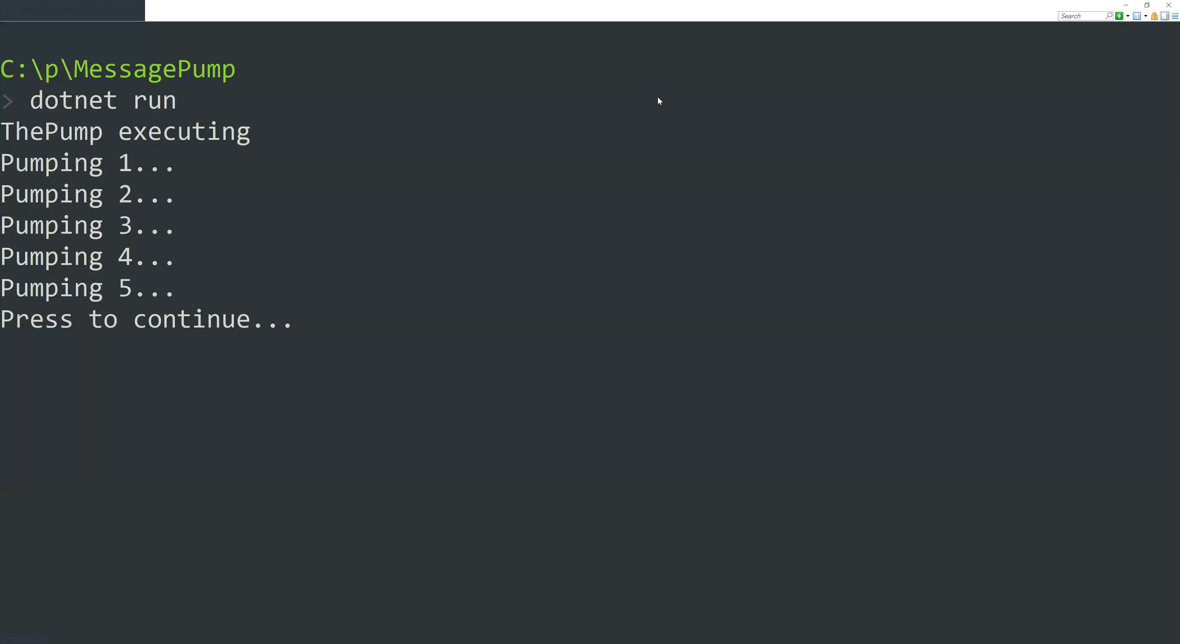

Slide 18
Better limit
concurrency
Notes:
TheLimitingConcurrencyPump.cs
If only we could tweak the pump to the weakest element (the code that is called). For example if a standard DB connection pool can have 100 connections it would be nice to only ever handle 100 messages concurrently to not overflow or even DDOS the system

Slide 19
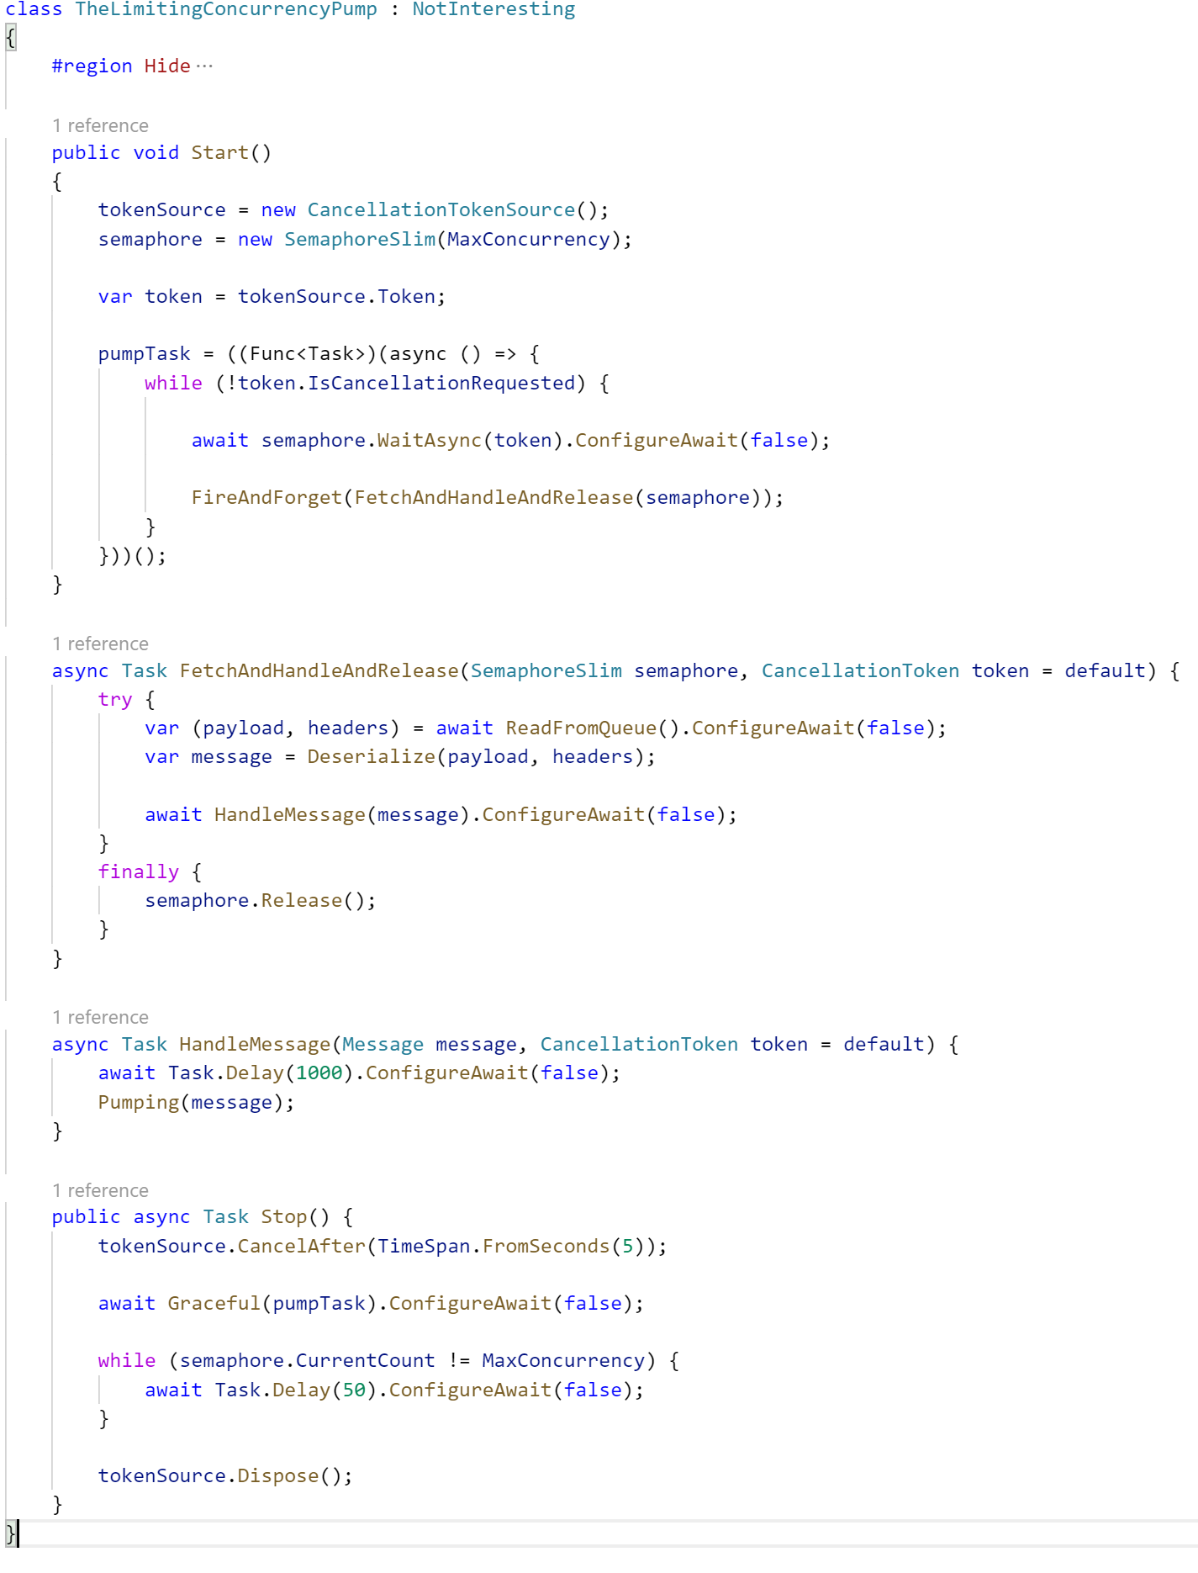
Notes:
Highlights:
SemaphoreSlim (faster than traditional Semaphore), explain semaphore when necessary

Slide 20
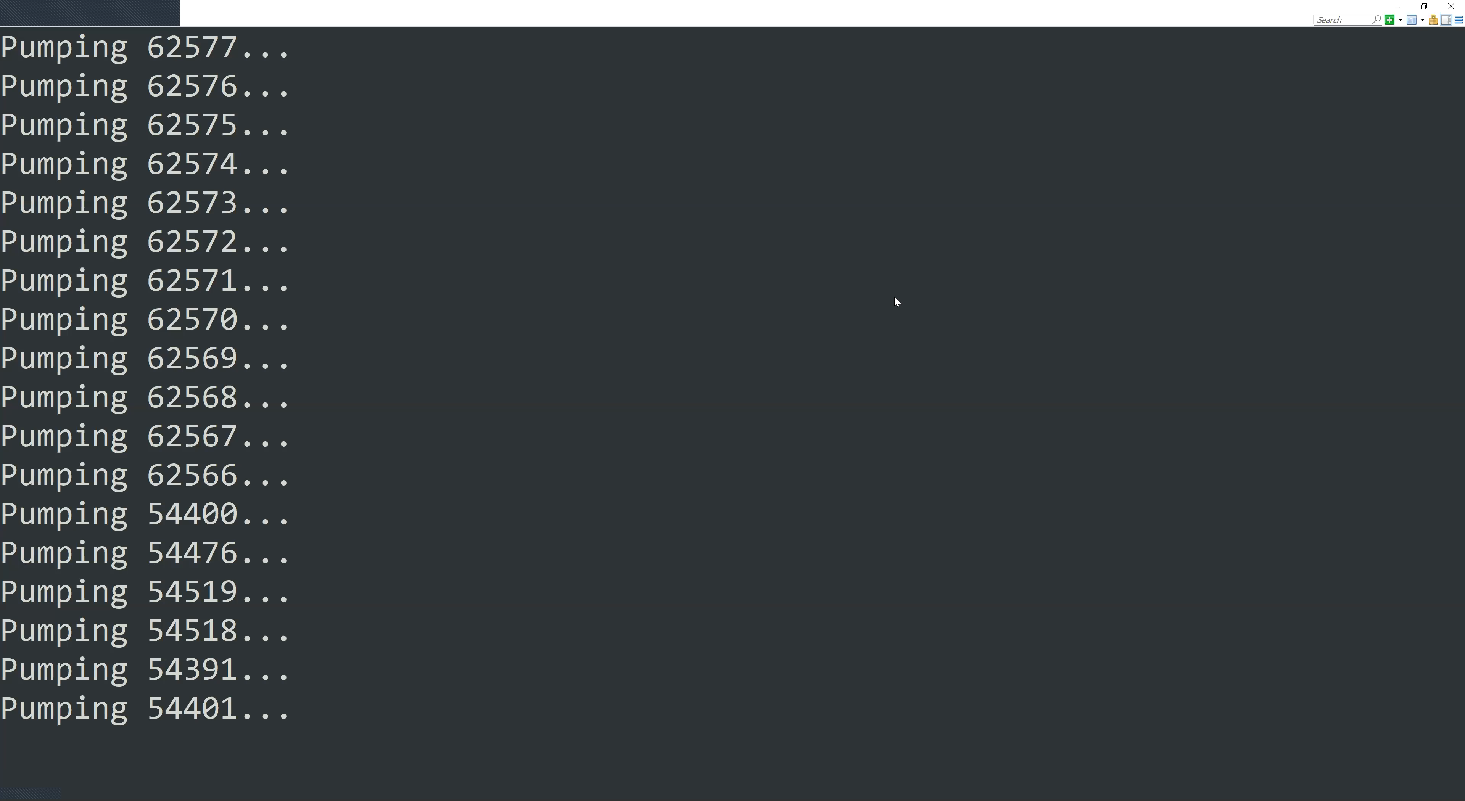

Slide 21
Semaphore controls floodgate
Ship it!
It worked
Notes:
Highlights:
We saw how we can use on a process level a simple semaphore to control the floodgate and control the concurrency per process
With that in place we have tighter control over the runtime behavior of the pump

Slide 22

As time passes
Notes:
Building the abstraction was a fun exercise. It is so cool when I can distract myself with writing infrastructure code instead of needing to fiddle with damn business requirements. I had this Mercedes Benz (sorry we are in Norway I meant Tesla Model 3) in mind but … I, The team lead, who originally built the abstraction did not really have time to maintain the things
So the team extended it under pressure, yeah it is all the teams fault ;)

Slide 23
Make it
flextensible
Notes:
Over time we had more and more requirements that the pump needed to fulfill, let’s see how the code started to look like
ThePumpHowItProbablyLooksLikeInReality,cs

Slide 24
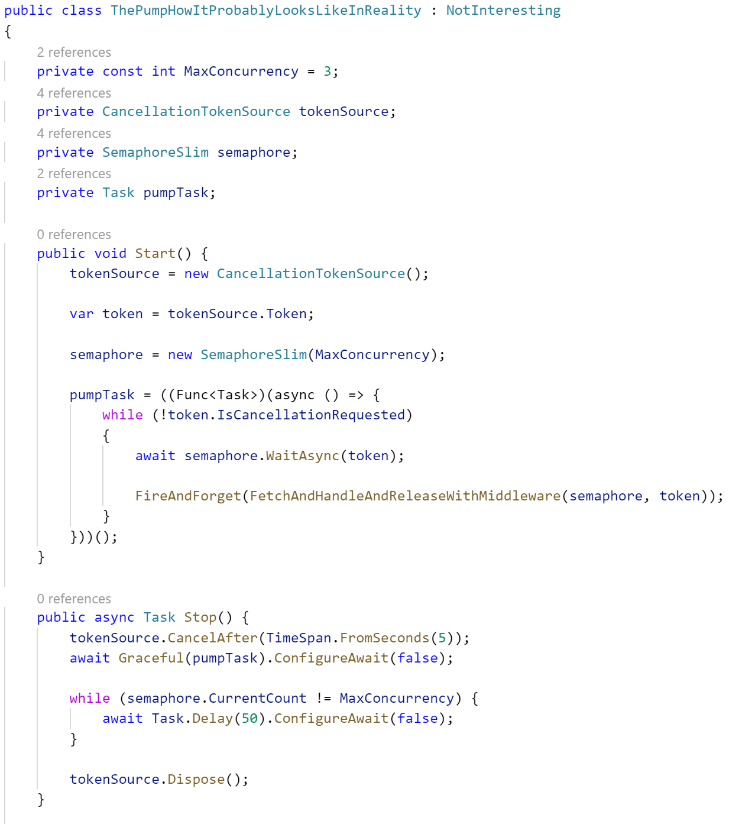


Slide 25
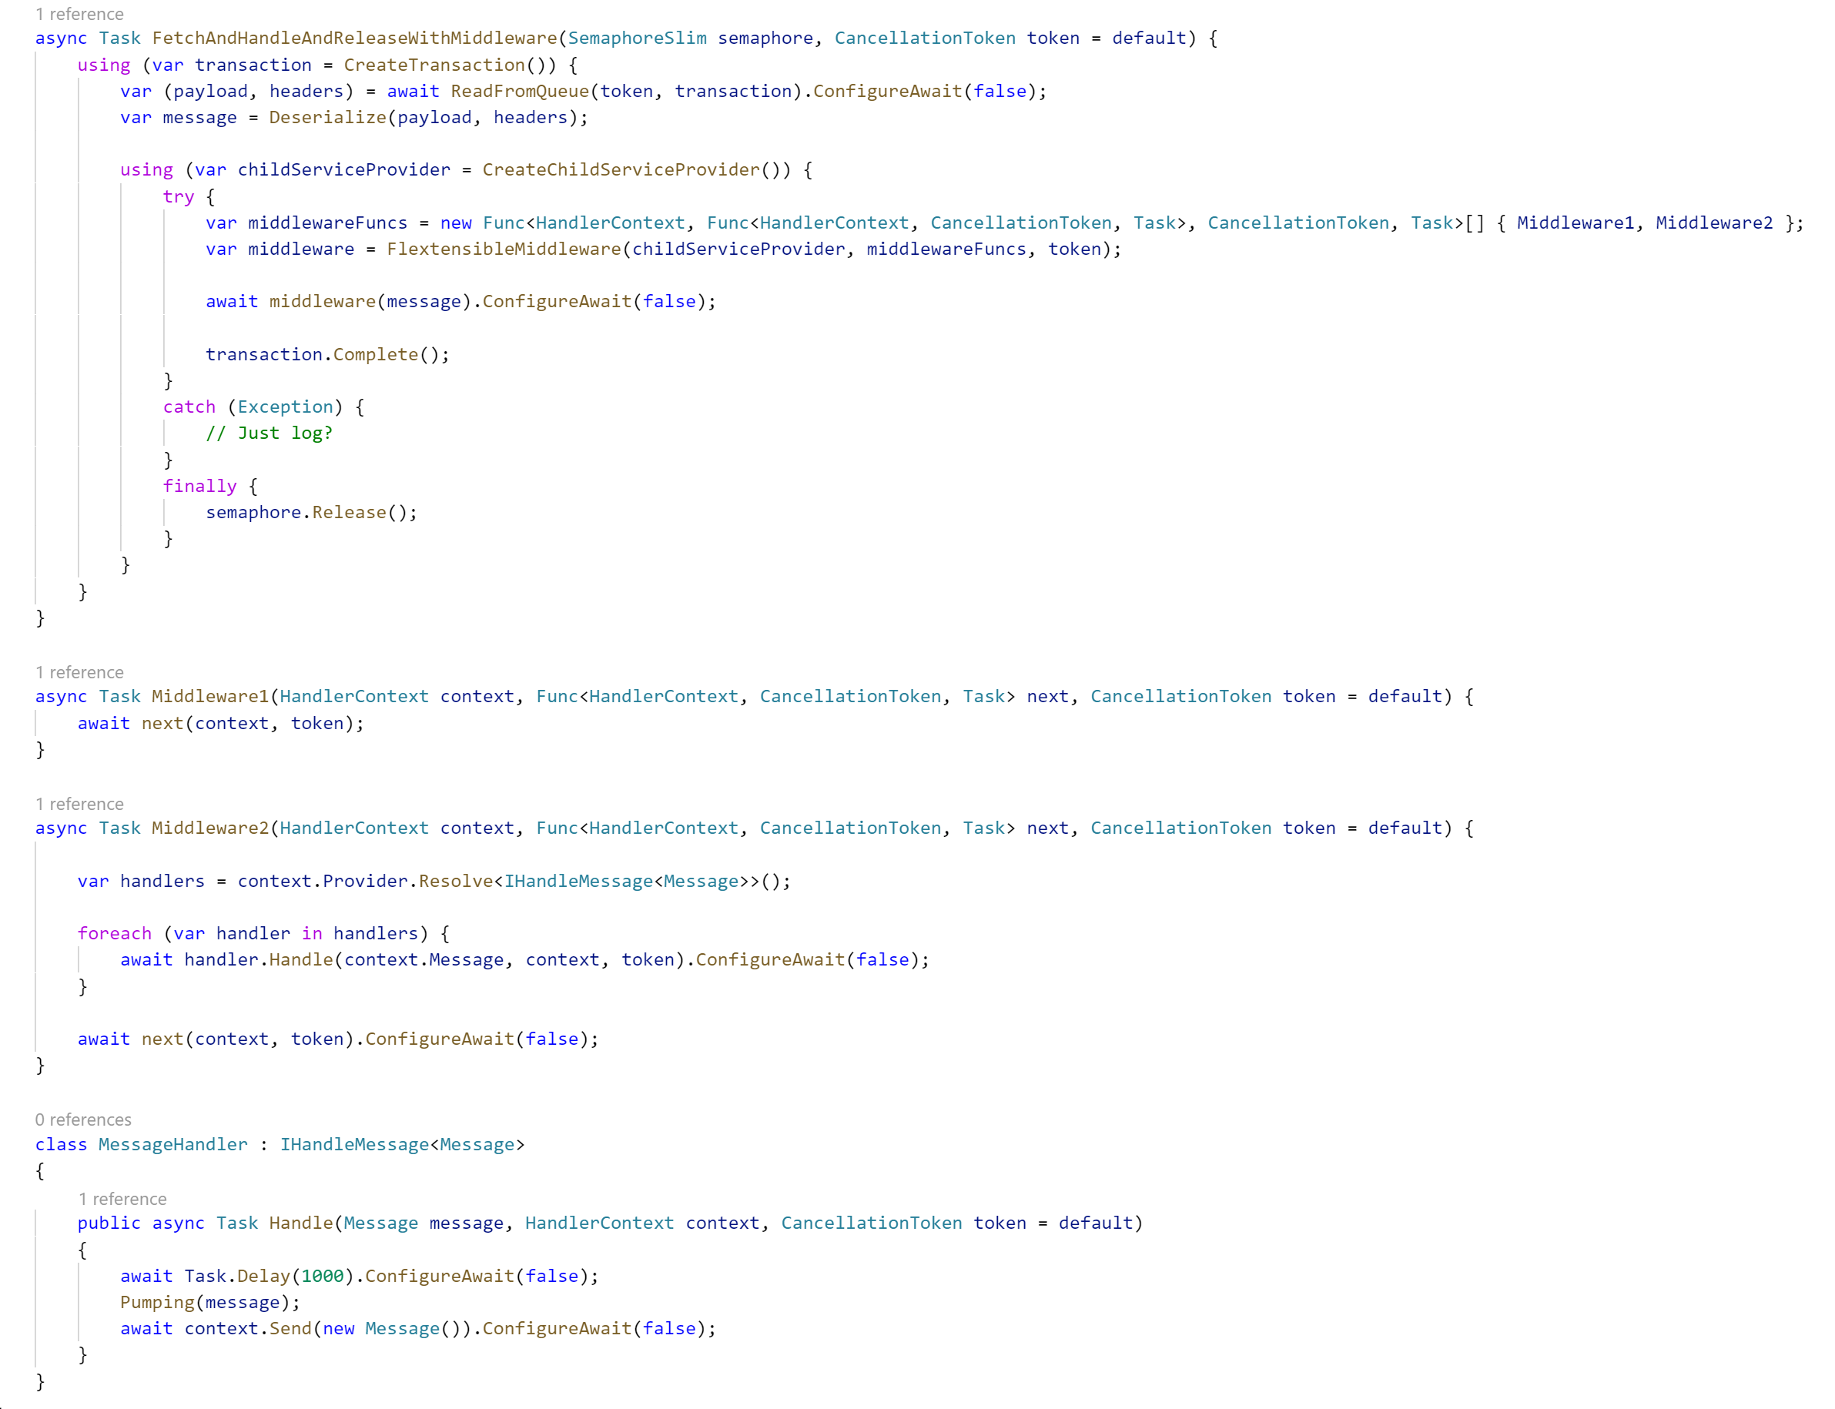


Slide 26



https://www.ala.co.uk/connect/top-10-crazy-cars/
https://www.americanroadmagazine.com/forum/gallery/image/1754-crazy-car-hi-res/
Notes:
How it really looked like, but it really depended upon who you’d ask in the team ;)

Slide 27
Life beyond
transactions
Notes:
We showed the basic bits send and receive as well as tx
Let’s have a deeper look at transactions and why you’d want to at least think about transactions

Slide 28
Pump
Tx Start
Your Code
Destination1
Destination2
Tx Commit / Abort
Storage
Notes:
Code that is executed under a message being received is never side effect free
As part of the code you might send out more messages or
You save state to your database
On premises with MSMQ and SQL Server (if you know what you are doing) the transactions can automatically enlist with the distributed transaction coordinator under a transaction scope. Both sending messages and manipulating data, are guaranteed to be executed (eventually) as a whole or rolled back as a whole. So the way you structure your code and your sends/published with the data access doesn’t matter
Connecting the pump and the sender i.e. how to you pass the transaction context through the user code so that if you send a message in a handler, it uses the same transaction as the pump created
If you need more high throughput on premises you might need to move to RabbitMQ, at that point your are not only throwing away all the underlying plumping code but the move has larger implications on how your code might behave at runtime
(next)

Slide 29
Pump
Tx Start
Your Code
Destination1
Destination2
Tx Commit / Abort
Storage
Notes:
RabbitMQ doesn’t provide cross queue transactions. It only supports ReceiveOnly transactions. In this mode the receive operation is wrapped in a transport's native transaction. The native transaction is implemented by either Acking or Nacking the message. This mode guarantees that the message is not permanently deleted from the incoming queue until at least one processing attempt (including storing user data and sending out messages) is finished successfully.
In this mode some (or all) handlers might get invoked multiple times and partial results might be visible:

Slide 30
Pump
Tx Start
Successful
Destination1
Destination2
Failed
Tx Commit / Abort
Storage
Notes:
partial updates - where one handler succeeded updating its data but the other didn't

Slide 31
Pump
Tx Start
Your Code
Destination1
Destination2
Tx Commit / Abort
Storage
Notes:
partial sends - where some of the messages has been sent but others not (click)
When using this mode all handlers must be idempotent, i.e. the result needs to be consistent from a business perspective even when the message is processed more than once.
And the position of the code where you place it and how you do exception handling can mean robust code or message loss and thus money loss

Slide 32
Cloudy with a chance of
F
ailur
e
Notes:
And what happens if you need to move your code to the cloud because your on-premises datacenter is not cost-effective?
AWS SQS only provides you ReceiveOnly transaction mode but the transaction mode is implemented by using a timeout mechanism called visibility time.

Slide 33
Pump
Handler
Notes:
Same by the way for Azure Storage Queues. That means if the message processing is not done during the visibility time the broker will automatically release the message for being processed by someone else. So you have to make sure you control the visibility timeout and potentially extend it while processing messages
For Azure Service Bus many people don’t know that the broker natively supports SendsWithAtomic receive.

Slide 34
Pump
Tx Start
Your Code
Destination1
Destination2
D1
D2
Tx Commit / Abort
Storage
Notes:
It works with a SendVia header and a TransactionScope that only SDK operations are allowed to enlisten to (volatile enlistement).
Transport support enlisting outgoing operations in the current receive transaction. This prevents messages being sent to downstream endpoints during retries.
This mode has the same consistency guarantees as the Receive Only mode, but additionally it prevents occurrence of ghost messages since all outgoing operations are atomic with the ongoing receive operation.
So far about the transactional capabilities of a transport. But when our code needs to embrace the cloud or even remote resources in an efficient manner we have to take latency and bandwidth into account.

Slide 35

Penny Pinching
Notes:
Especially in the cloud every request to the broker counts. For example Azure Service Bus has the concept of operations per second.
First 13M ops/month Included Next 87M ops (13M–100M ops)/month $0.80 per million operations. That sounds like an awful lot of requests that we can make. After all 13 or 87 million is a huge number right? Well with 87 million we can do 120 requests per hour. That is not that much considering every receive and send counts as an operation.
For ASB you also get charged by the number of AMQP connections. First 1000 connections per month are included in the standard tier after that Next 99K (1K–100K)/month$0.03 per connection/month.
But things can get worse.

Slide 36
foreach(var message in messsagesToBeSent) {
await SendMessage(message);
}
Broker
Latency / Operation costs
Notes:
Consider your code sends messages out in a foreach loop after a message was received. If you do an naïve approach every send operation is an operation to the broker. So in order to maximize the cost savings and reduce latency to the broker (remember latency affects every call that you make) we have to put as much as we can into a single call. Batching is the concept we want to apply (btw. That also helps with ghost messages that we talked about before but that is a topic for another talk)

Slide 37
Destination 1
Destination 2
256 KB
Headers
Body
All the messages to be sent
Notes:
I handwaved and said as much as we can into one call. Unfortunately every transport has different constraints when it comes to how much data can be put into a call. For example Azure Service Bus can batch up to 256 KB of data in the standard tier. AWS SQS the same. Azure Storage Queues can batch up to 64 KB. RabbitMQ you can shuffle as much data as you want but the throughput might suffer tremendously. Now you are faced with writing a smart batching logic that figures based on the payload (headers and body) how much data can be put into a single call while still being able to keep all the transactional guarantees. Plus you have to deal with SDK and broker dependent behavior. For example if you use SendsWithAtomicReceive with ASB and send messages to multiple destinations you need to batch by SendVia route. With AWS SQS even if you send batches individual messages within a back can fail and then your code needs to fallback to retry those individual messages. Fun times!
Animation

Slide 38
Now we have the
basic bits
Notes:
You know have the building blocks (sending, receiving and transactions) to build your own message pump.
We know when our software grows the demands that we have to our infrastructure, library and frameworks grows as well.

Slide 39
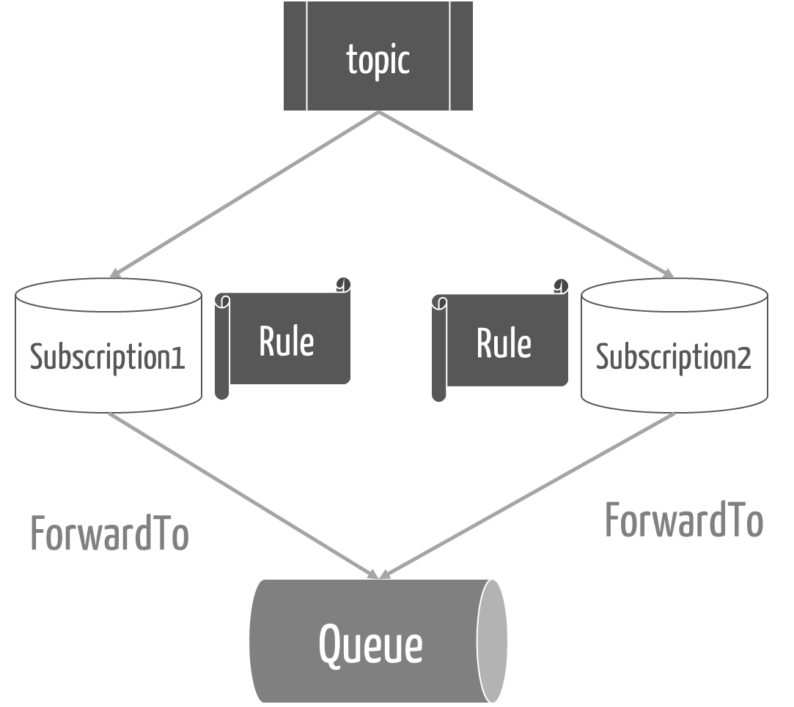
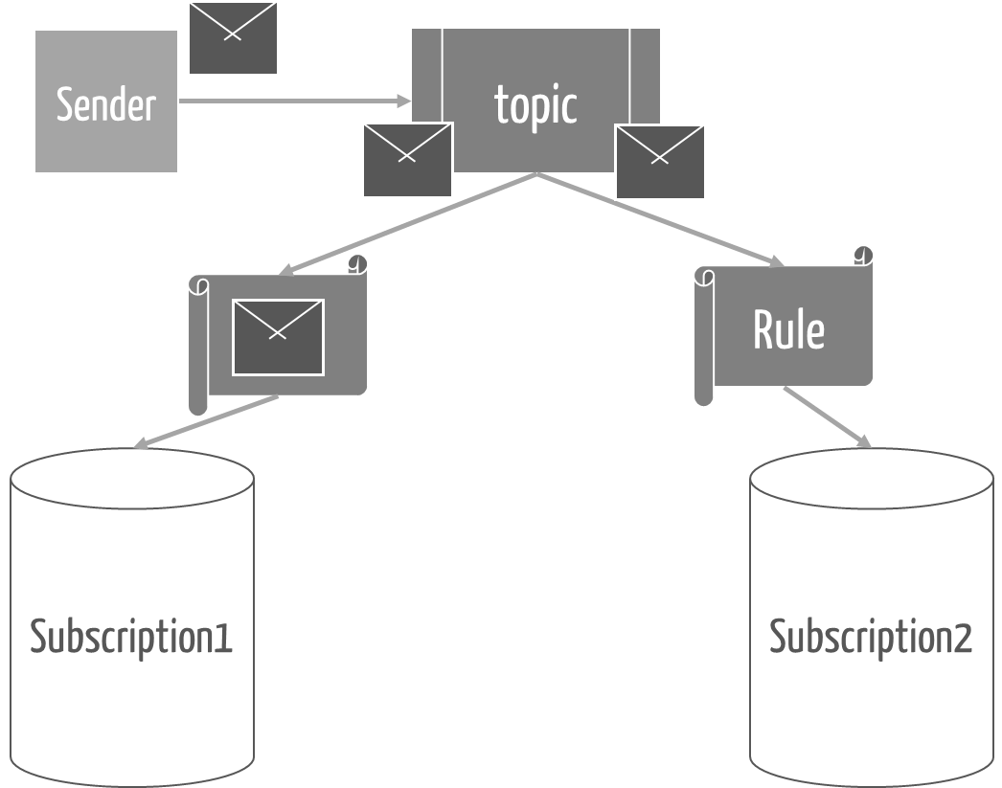
Pub / Sub
Notes:
One you go over simple message sending and message receiving into pub sub land you are basically confronted with common up with the right topology on the broker technology of choice. Unfortunately some queuing technologies like AmazonSQS or Azure Storage Queues only offer simple queuing semantics. Any higher level pub sub semantic needs to be built by managing the topology reliably in a subscription storage (for example Azure Tables) or plug in other services like Amazon SNS.
More advanced brokers like RabbitMQ or Azure ServiceBus offer higher level semantics to build pub sub hierarchies. For example RabbitMQ has the notion of Topics, Exchanges and Bindings that can be mapped with routing filters to input queues.
Azure Service Bus has the concept of Topics, Subscriptions and Rules that allow to build fairly advanced topologies. But you have to make the right choice by taking into account whether you require polymorphic event dispatch for example.
Topology changes are complex when you need to deal with inflight messages
If more than 5 min left go ahead otherwise skip the next two slides

Slide 40
Sender
topic
Rule
Rule
Subscription1
Subscription2
Notes:
Senders only knows Topics
Receivers only know about Subscriptions
Subscriptions have Filters (rules) and Actions
Rules evaluated using OR (SQL) or AND (Correlation) logic
Messages are sent to a topic and delivered to one or more associated subscriptions, depending on filter rules that can be set on a per-subscription basis. The subscriptions can use additional filters to restrict the messages that they want to receive. Messages are sent to a topic in the same way they are sent to a queue, but messages are not received from the topic directly. Instead, they are received from subscriptions. A topic subscription resembles a virtual queue that receives copies of the messages that are sent to the topic. Messages are received from a subscription identically to the way they are received from a queue.
But you need to manage subscription clients and queue clients which significantly increases the complexity of the code. A simpler approach is for example

Slide 41
topic
Subscription1
Rule
Rule
Subscription2
ForwardTo
ForwardTo
Queue
Notes:
Here is a quick example of a topology I call Forwarding Topology with Azure Service Bus.

Slide 42

Living on the edge of sanity
Notes:
Go in depth if required, leave out details if not enough time
But what about delayed delivery, scaleout, competing consumer, state management, runtime configuration for routing to adjust to topology changes, pub/sub, retries, connection pooling etc.
Human factors that go beyond the code
Documentation, How do you teach new developers that join the team
What happens when you the mastermind leaves the team

Slide 43


Sorry pal but we got a problem in prod. Should I call your spouse or will you?
Notes:
But now you have this dist systems mess.
How the heck do you know what is going on
How to troubleshoot
How to monitor
How to visualize
How to determine whether the consumers are coping with the load
Put into production
New customer acquired and CEO asked if the system can handle the load
Or Outage in production and there was no insight
These distributed systems are complex, there’s no denying that, so you need tooling to make sure everything is running properly and to get insights into it. Using a monitoring system is not that hard. Setting up all the hooks into the middleware might be though

Slide 44
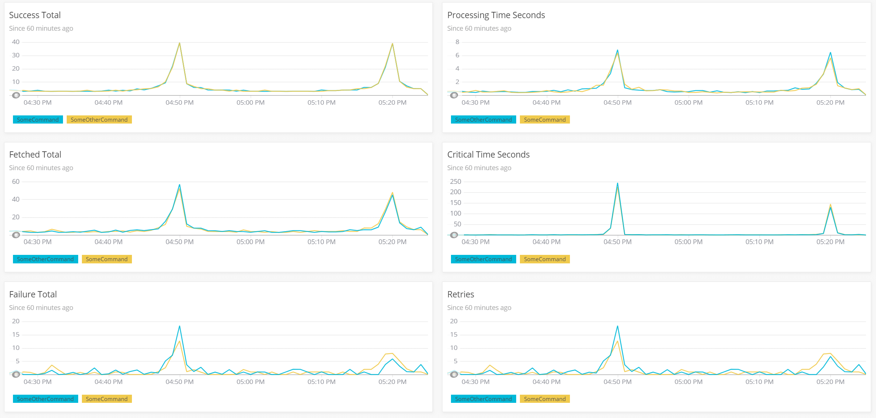
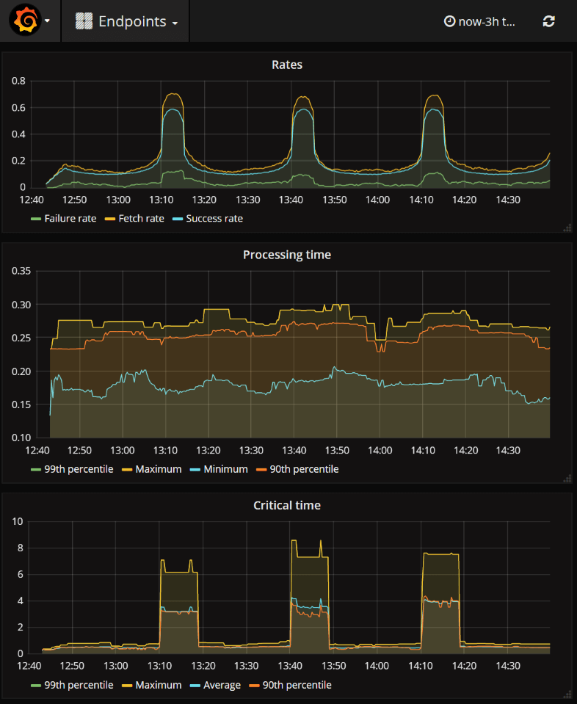
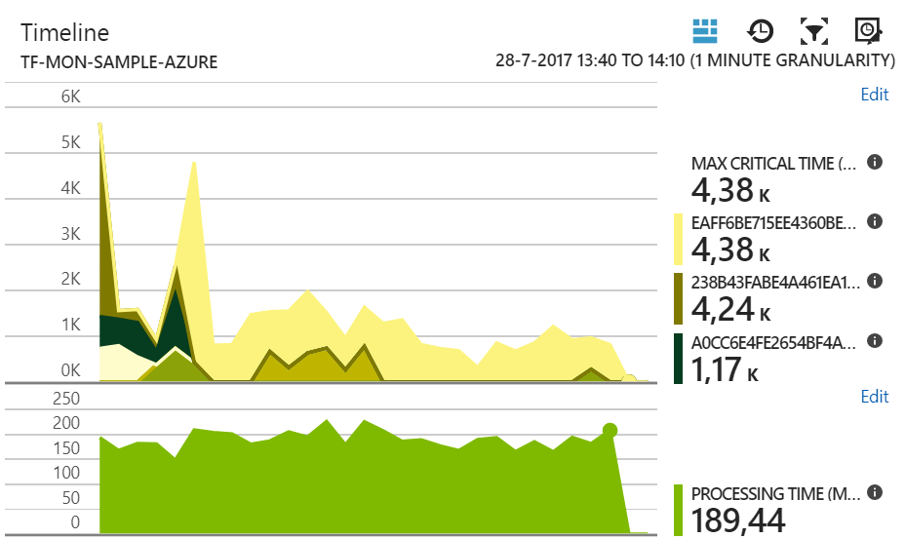
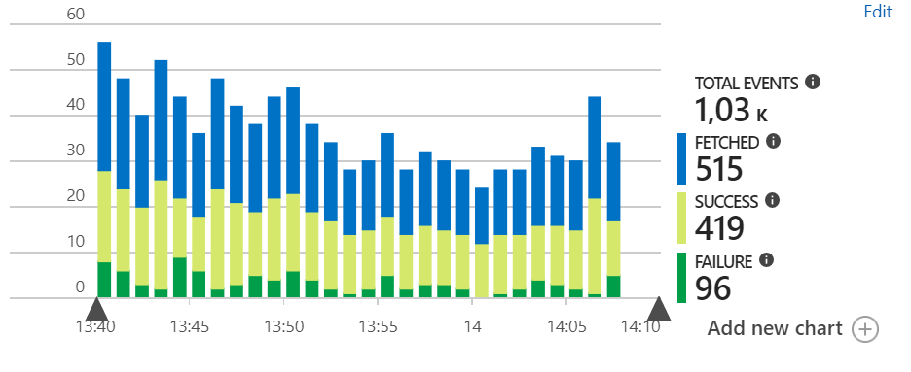
Notes:
You can also ship data to App Insights or (name drop some shit) Grafana, Prometheus, all that stuff, this is just one example

Slide 45

Try it yourself
Notes:
I strongly encourage you to try this yourself on a personal project or a small part of your work project. Knowing the inner workings of a message pump is valuable, even if you don't end up using it in production. Being armed with this knowledge helps you to make the right tradeoffs in your projects when it comes to the make or buy decision.

Slide 46
Thanks
Notes:
Thanks

Slide 47
Slides, Links…
github.com/danielmarbach/MessagePump

Slide 48

Software Engineer
Microsoft MVP
@danielmarbach
particular.net/blog
planetgeek.ch
Notes:
I’m Daniel, Solution Engineer…
I live in central Switzerland. If you want to know more about me listen to episode 77 of developer on fire
You can reach me on twitter under @danielmarbach
I blog on the particular blog and on my personal blog
I’m the lead behind the asyncification of NServiceBus and the ecosystem around it
I regularly contribute back ideas and code changes to asyncify the .NET OSS libraries and frameworks out there. So far I contributed to Entity Framework, RabbitMQ, Marten, MassTransit, Quartz.NET and many more

Slide 49
Thanks
Notes:
Thank you very much for listening and see you next time

